Slide 1


Java File Handling
A Beginner's Guide with Practical Examples

Slide 2





Introduction to File Handling
What is File Handling?
Why is it Important?
File handling in Java refers to the process of working with files stored on a computer's file system. This includes operations such as creating, reading, writing, updating, and deleting files.
Data Persistence: Store data permanently, even after the program closes.
Configuration: Read application settings from files.
It's a fundamental aspect of many applications, allowing programs to interact with persistent data beyond their execution lifetime.
Logging: Record program events and errors.
Data Exchange: Share data between different applications or systems.

Slide 3




Key Concepts in Java File I/O
1. Streams
2. Stream Types
3. The File Class
A sequence of data representing a flow from source to destination.
Byte Streams:
Represents a file or directory path on the system.
Handle raw binary data (images, audio, text).
Types:
Classes:
InputStream
,
OutputStream
.
Key Functions:
Input Stream: Read data from a source.
•
Check existence
Character Streams:
•
Output Stream: Write data to a destination.
•
Get file properties
Handle text data with auto-encoding.
•
Create/Delete files
Classes:
Reader
,
Writer
.
•
Manage directories
•

Slide 4





Basic File Operations
1. Creating a File
2. Writing to a File
Use the
File
class to initialize a file object and
Use
FileWriter
or
BufferedWriter
to send character
createNewFile()
to create it on disk.
data into a file.
3. Reading from a File
4. Deleting a File
Use
Scanner
or
BufferedReader
to retrieve data from a
Use the
delete()
method of the
File
class to remove a
stored file.
file from the system.

Slide 5
Example 1: Creating a File
import java.io.File; import java.io.IOException; public class CreateFile { public static void main(String[] args) { try { File myFile = new File("my_first_file.txt"); if (myFile.createNewFile()) { System.out.println("File created: " + myFile.getName()); } else { System.out.println("File already exists."); } } catch (IOException e) { e.printStackTrace(); } } }
How it Works
01.
Import
java.io.File
and
java.io.IOException
for file operations and error
handling.
02.
Create a
File
object. This doesn't create the file
on disk yet, just a reference to the path.
03.
Call
createNewFile()
. It returns
true
if a new
file is created, and
false
if it already exists.
04.
Use a
try-catch
block to handle
IOException
,
which is required for most file operations.

Slide 6
Example 2: Writing to a File
import java.io.FileWriter; import java.io.IOException; public class WriteToFile { public static void main(String[] args) { try { FileWriter writer = new FileWriter("my_output.txt"); writer.write("Hello, Java File Handling!\n"); writer.write("This is a second line."); writer.close(); // Important: close the writer System.out.println("Successfully wrote to the file."); } catch (IOException e) { e.printStackTrace(); } } }
How it Works
1
FileWriter: We use this class to write character data to the specified file.
2
write(): This method adds the string content into the file buffer.
3
close(): Crucial step! It flushes the data to the disk and releases system resources.
4
Exception Handling:
File operations must be
wrapped in try-catch to handle
IOException
.

Slide 7
Example 3: Reading from a File
import java.io.File; import java.io.FileNotFoundException; import java.util.Scanner; public class ReadFromFile { public static void main(String[] args) { try { File myFile = new File("my_output.txt"); Scanner myReader = new Scanner(myFile); while (myReader.hasNextLine()) { String data = myReader.nextLine(); System.out.println(data); } myReader.close(); } catch (FileNotFoundException e) { System.out.println("An error occurred."); e.printStackTrace(); } } }
How it Works
1. Scanner Class
The
Scanner
class is a versatile tool that can read
from various sources, including files.
2. Iteration
hasNextLine()
checks if there is another line of text,
while
nextLine()
retrieves it.
3. Resource Management
Always call
close()
on the Scanner to release the file
lock and system resources.
4. Exception Handling
Reading requires handling
FileNotFoundException
in case the target file is missing.

Slide 8

Example 4: Appending to a File
import java.io.FileWriter; import java.io.IOException; public class AppendToFile { public static void main(String[] args) { try { // true for append mode FileWriter writer = new FileWriter("my_output.txt", true); writer.write("\nThis line is appended.\n"); writer.write("Another appended line."); writer.close(); System.out.println("Successfully appended."); } catch (IOException e) { e.printStackTrace(); } } }
How it Works
By default,
FileWriter
overwrites the existing
file content.
To append data, we use the constructor that accepts a boolean flag.
Key Detail:
The second argument
in
new FileWriter(file, true)
true
tells Java to start writing at the end of the file
instead of the beginning.

Slide 9


Example 5: Deleting a File
import java.io.File; public class DeleteFile { public static void main(String[] args) { File myFile = new File("my_first_file.txt"); if (myFile.delete()) { System.out.println("Deleted the file: " + myFile.getName()); } else { System.out.println("Failed to delete the file."); } } }
How it Works
The
delete()
method of the
File
class is used
to remove a file or an empty directory.
It returns a
boolean
value:
true
if successful,
false
otherwise.
Important Note:
Deletion is permanent! There is no "recycle bin" for files deleted via Java code. Always ensure you have the correct file path before calling this method.

Slide 10
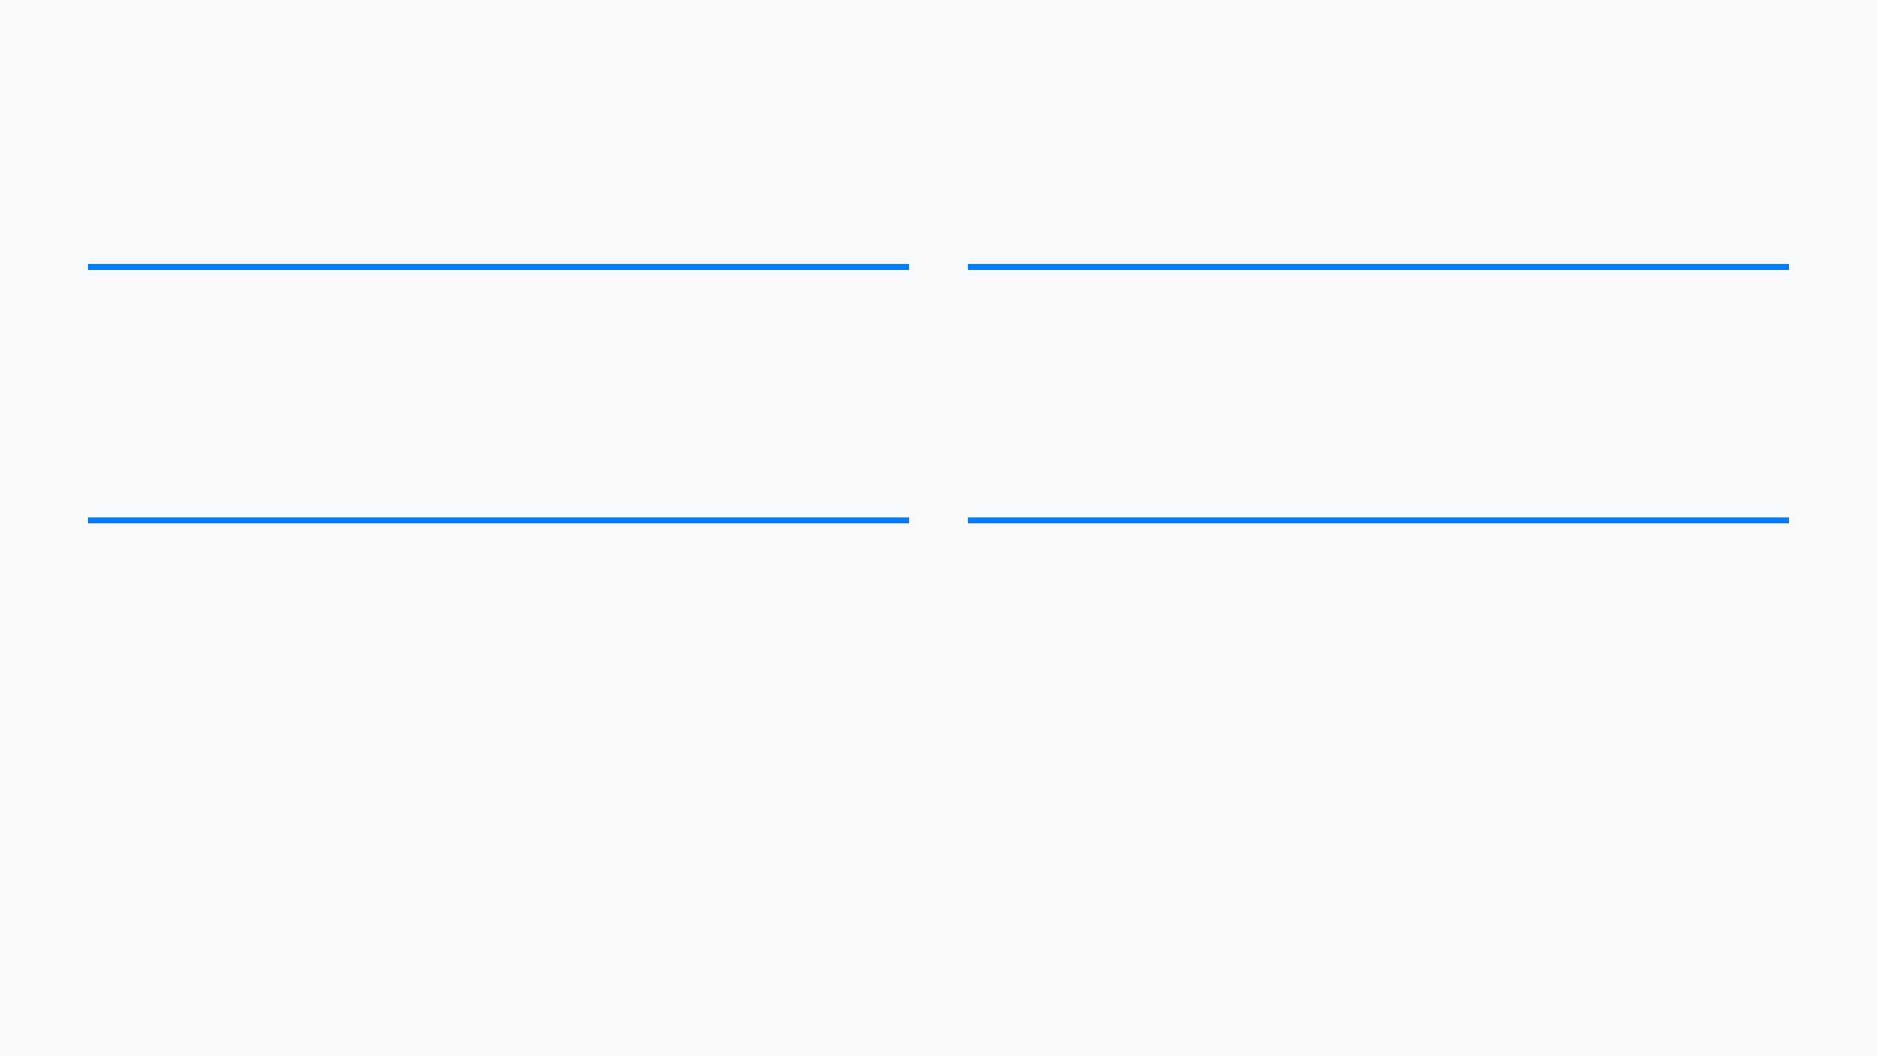




Best Practices for File Handling
Always Close Streams
Robust Error Handling
Use
try-with-resources
(Java 7+) to automatically close
Implement
try-catch
blocks to gracefully handle
IOException
streams and writers, preventing memory and resource leaks.
and other file-related exceptions.
Use Buffered Streams
Character Encoding
For performance, wrap
FileReader
in
BufferedReader
when
Be mindful of character encoding (like UTF-8) when reading or writing text files to ensure international characters display correctly.
dealing with large text files to reduce disk access.

Slide 11




Conclusion
Mastering Java File Handling
Persistence
Control
Efficiency
Enable your applications to store and retrieve data permanently on the disk.
Gain full control over file system properties, directories, and file lifecycle.
Use buffered streams and modern NIO.2 features for high-performance I/O.
Keep practicing with these examples and explore the java.nio.file package for advanced operations!

